Slide 1



Electric Motor SPEED
Project 263

Slide 2
Group Members
Mr.Kodati Bhanu Saikiran
Mr. Jarugubilli Ashok Kumar
Mr. Sushant Sadanand Kashikar
Mr. Parth Suhas Mane
Mrs. Dhanshri Bhaurao Sagle
MENTOR
Mr. Madishetti Rajashekar

Slide 3
Bussiness Objective
Efficiently Predict Motor Speed with Electric Motor Temperature.
Motor operators and maintenance teams often struggle to accurately predict motor speed based on available attributes.
Electric Motor Temperature uniquely solves this problem by utilizing sensor data from a PMSM deployed on a test bench

Slide 4
Feature Set explanation
Ambient Temperature:
The ambient temperature in an electric motor refers to the temperature of the surrounding environment where the motor is operating. It is typically measured using a thermal sensor located near the stator, which is the stationary part of the motor.
Coolant:
In an electric motor, coolant refers to a substance or fluid used to remove excess heat generated during operation and maintain the motor's temperature within safe limits. Coolants are commonly used in larger and more powerful electric motors, such as those found in industrial applications or electric vehicles.
Voltage d-component (u_d):
voltage d-component denoted as Vd, is a term used in the context of electric motors and refers to the voltage component that is aligned with the motor's d-axis. In electric motor theory, the d-axis is one of the two orthogonal axes (the other being the q-axis) that are commonly used to represent the magnetic field and currents within the motor.

Slide 5
Feature Set explanation
Voltage q-component (u_q):
voltage d-component denoted as Vq, is a term used in the context of electric motors and refers to the voltage component that is aligned with the motor's q-axis. In electric motor theory, the q-axis is one of the two orthogonal axes (the other being the d-axis) that are commonly used to represent the magnetic field and currents within the motor.
Motor Speed:
Motor Refers to the rotational speed at which the motor's rotor or shaft spins. It is typically measured in revolutions per minute (RPM) or radians per second (rad/s).
Torque:
In an electric motor, the torque induced by the current flowing through the motor's windings is referred to as the electromagnetic torque. This torque is responsible for producing the rotational motion of the motor's shaft.
Current d-component (i_d):
The d-component current is responsible for producing the torque and magnetic field alignment along the d-axis of the motor.

Slide 6
Feature Set explanation
Current q-component (i_q):
current q-component denoted as Iq, is a term used in the context of electric motors and refers to the current component that is aligned with the motor's q-axis. In electric motor theory, the q-axis is one of the two orthogonal axes (the other being the d-axis) that are commonly used to represent the magnetic field and currents within the motor.
Permanent Magnet (PM):
A permanent magnet (PM) is a component commonly used in electric motors to generate a magnetic field. It is a type of magnet that retains its magnetic properties without the need for an external magnetic field.
Stator yoke & tooth:
In an electric motor, the stator yoke is a component of the stator, which is the stationary part of the motor. The stator yoke forms the outer cylindrical or ring-shaped structure that encloses the stator core and windings.
In an electric motor, the stator tooth is a component of the stator, which is the stationary part of the motor. The stator teeth are the protrusions or salient poles on the inner surface of the stator core.
Stator winding :
The stator winding is an essential part of an electric motor's stator, which is the stationary component of the motor. The stator winding consists of coils or windings of insulated wire that are placed in the slots or openings of the stator core.

Slide 7
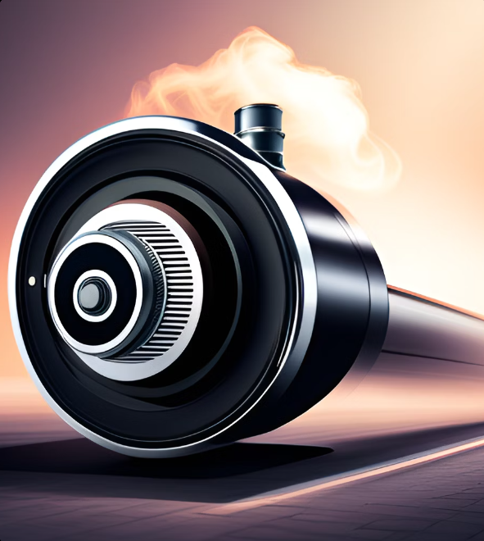
Exploratory Data Analysis

Slide 8
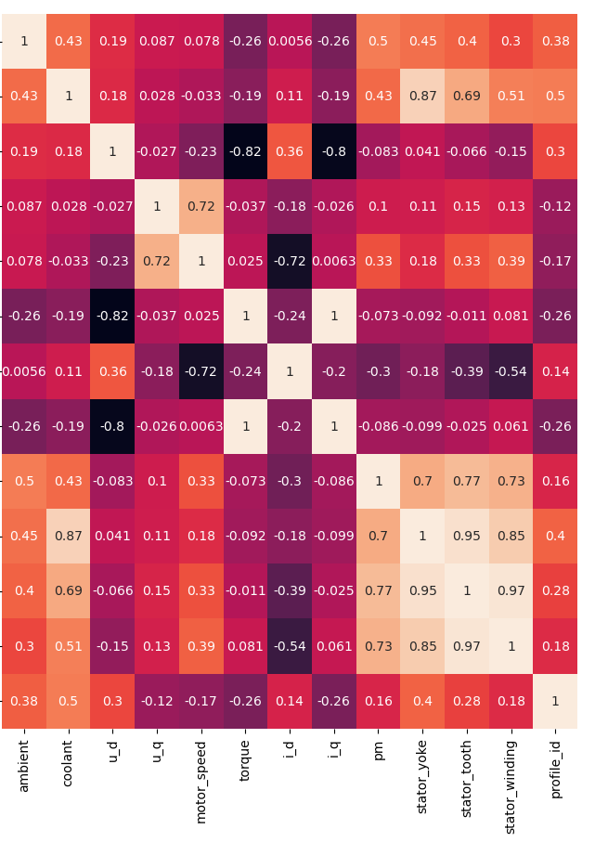
From the correlation of the given data we conclude that below are the strongly related varibales - 1) Positive strongly related - -coolant with stator_yoke. - -stator_yoke with stator_tooth. - -stator_winding with stator_tooth. - -stator_winding with stator_yoke. - -coolant with stator_tooth. - -u_q with motor_speed. - -torque with i_q. - 2) Negative strongly related - -u_d with i_q. - -i_d with motor_speed. - -u_d with torque.

Slide 9
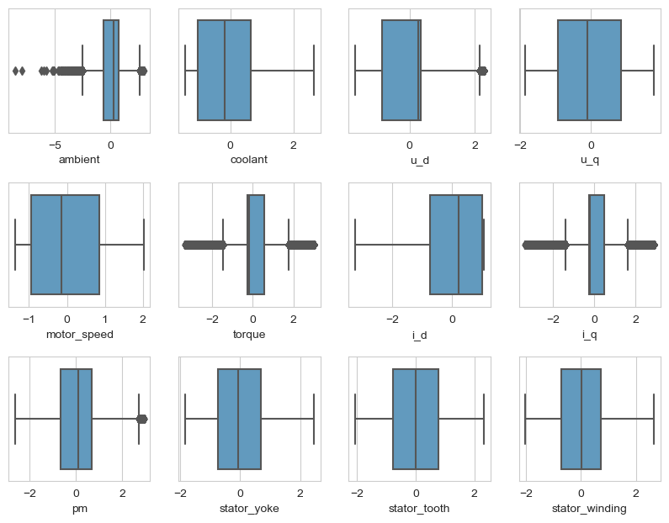
Boxplot

Slide 10
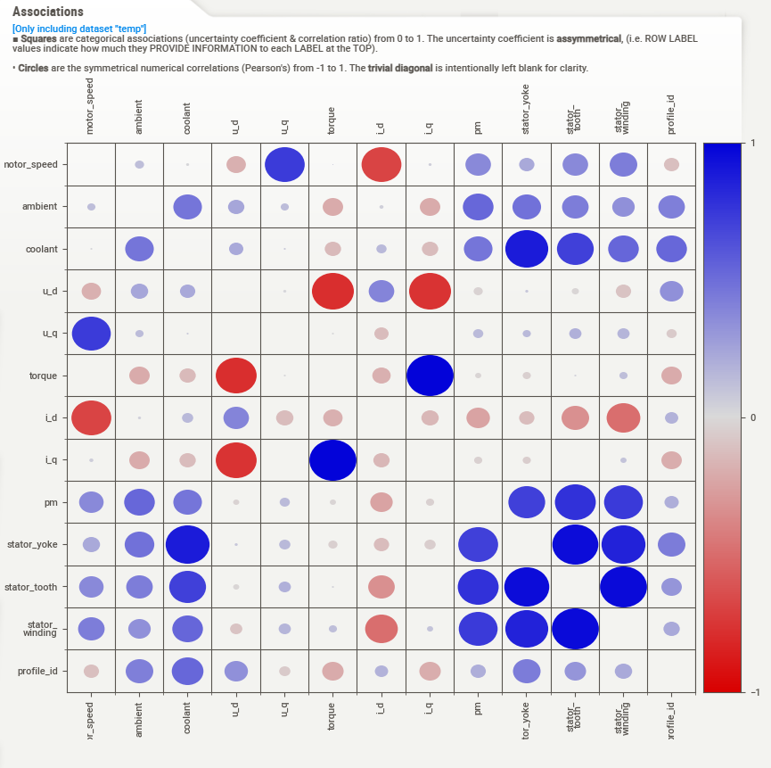
Corelation (Association) Matrix

Slide 11
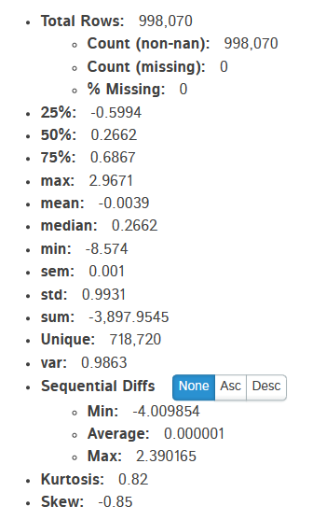
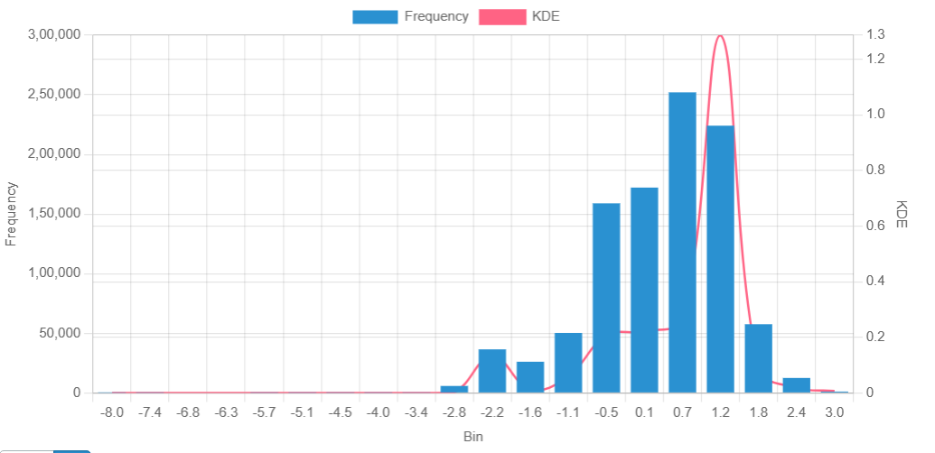
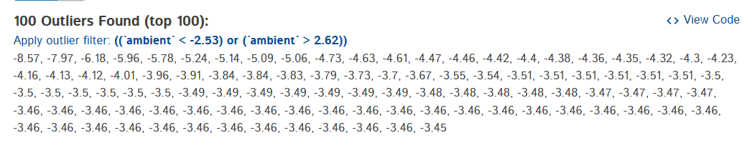
Ambient

Slide 12
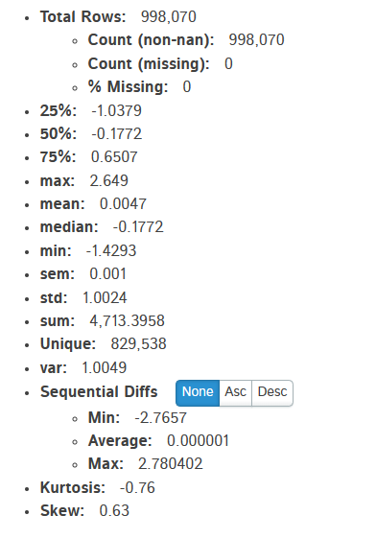
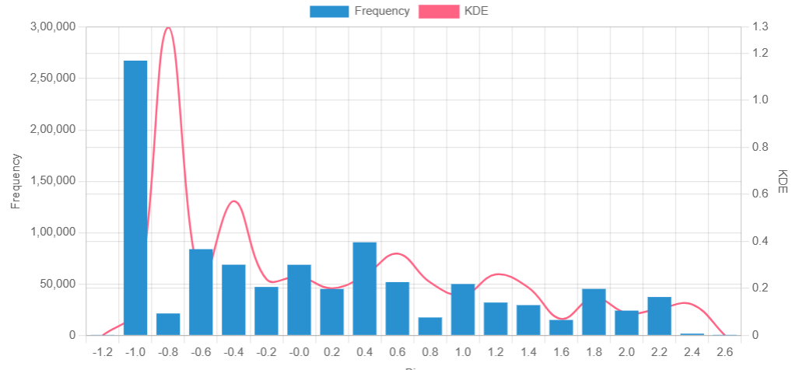

Coolant

Slide 13
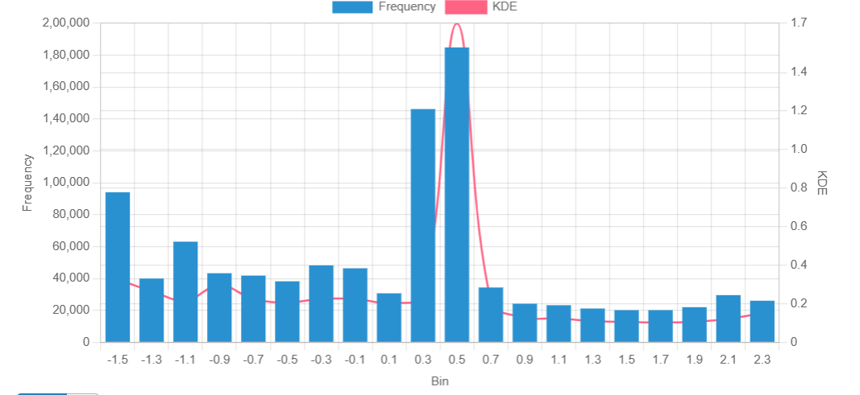
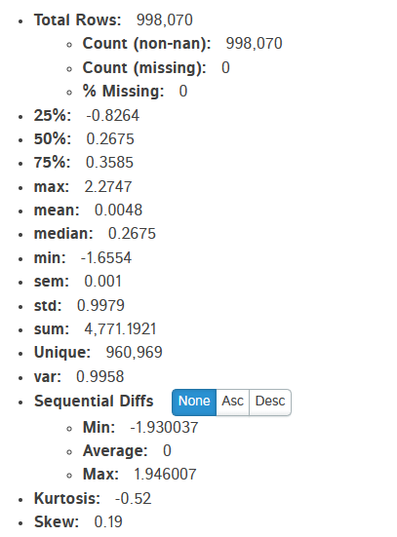
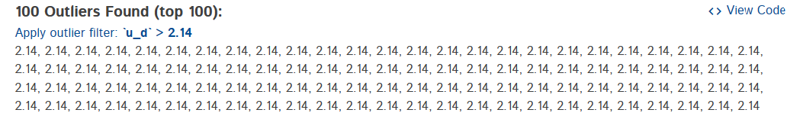
U_D

Slide 14
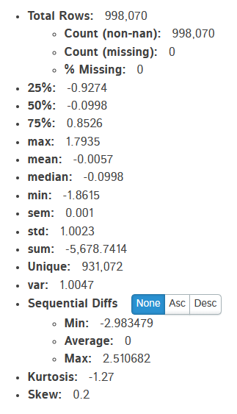
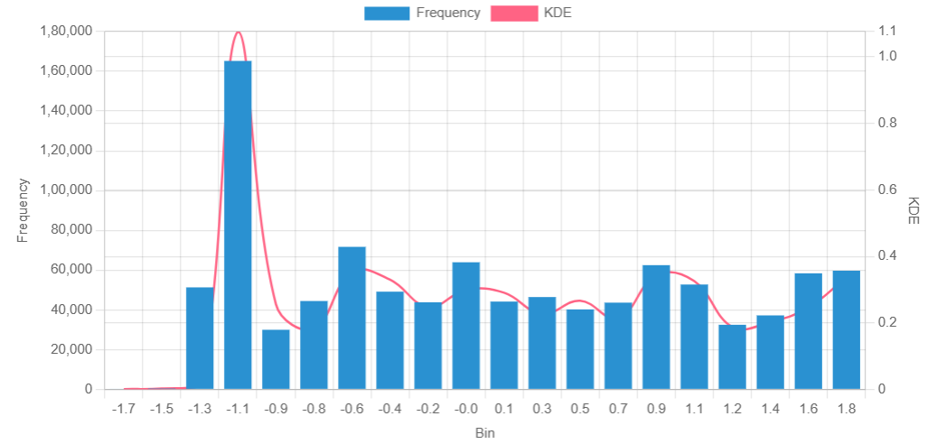

U_Q

Slide 15
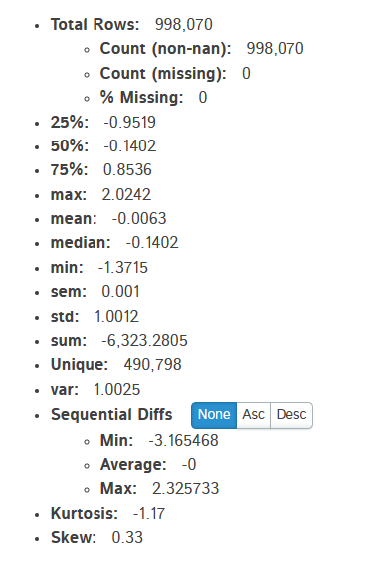
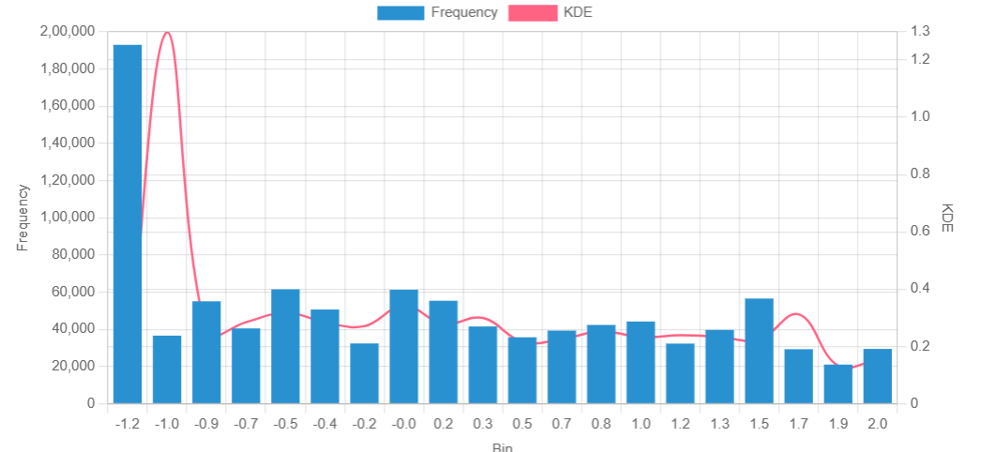
Motor Speed

Slide 16
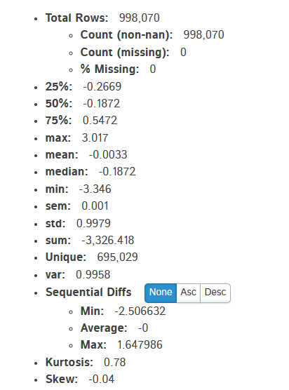
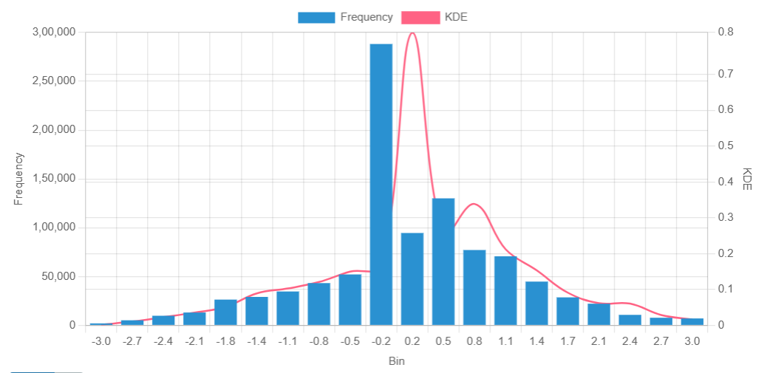
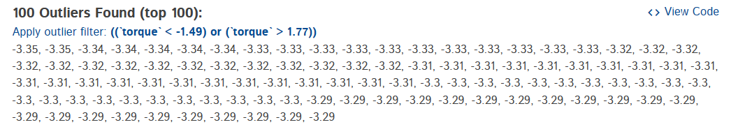
torque

Slide 17
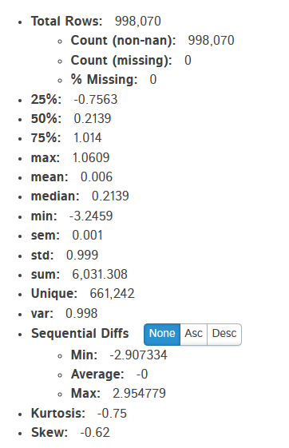
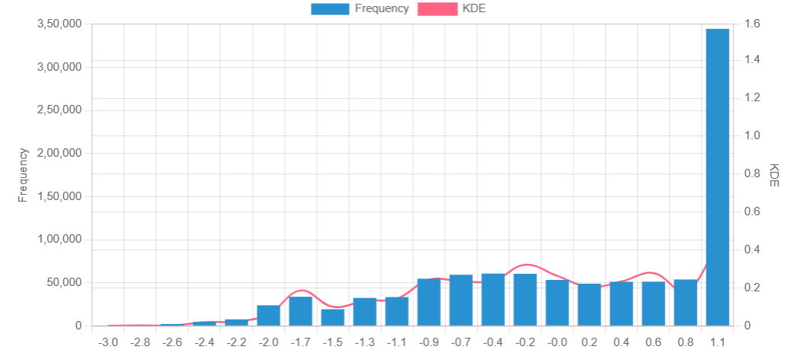
I_D

Slide 18
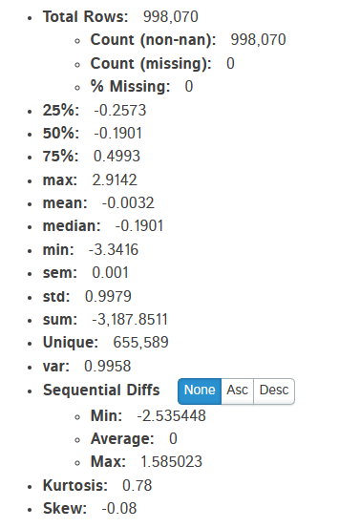
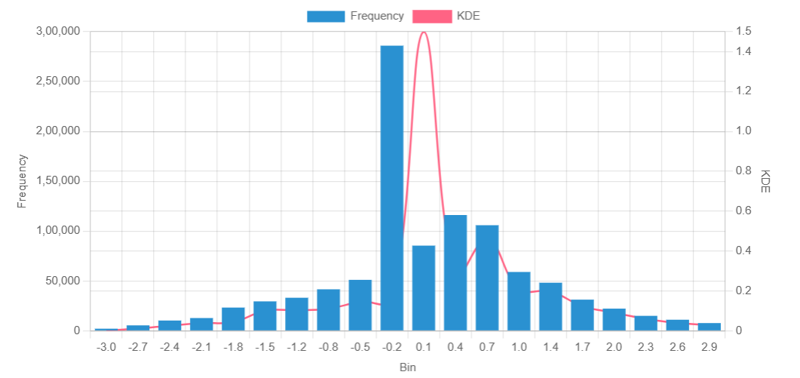
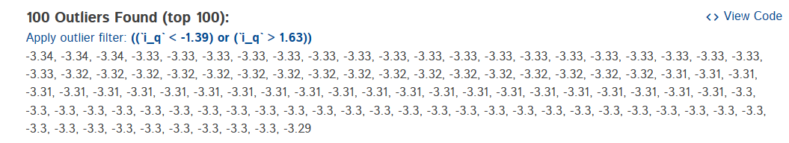
i_Q

Slide 19
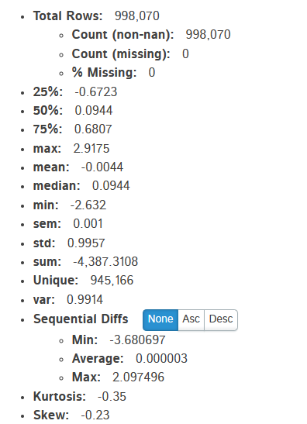
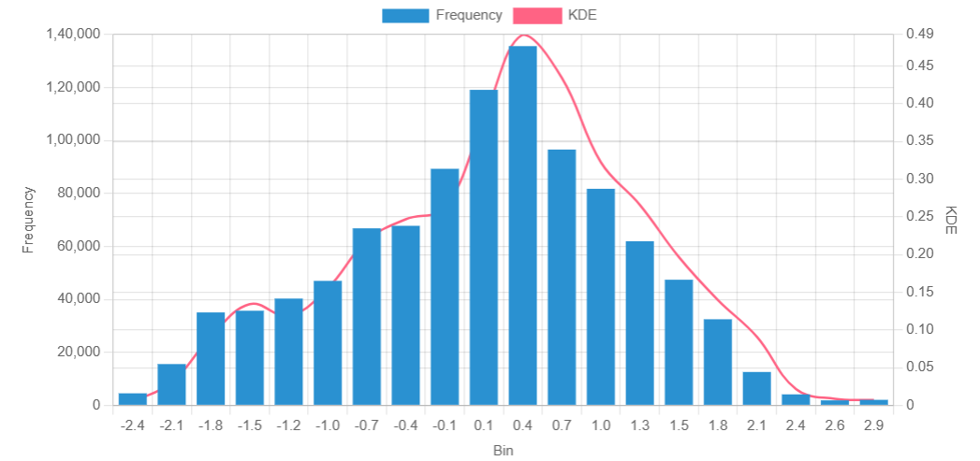
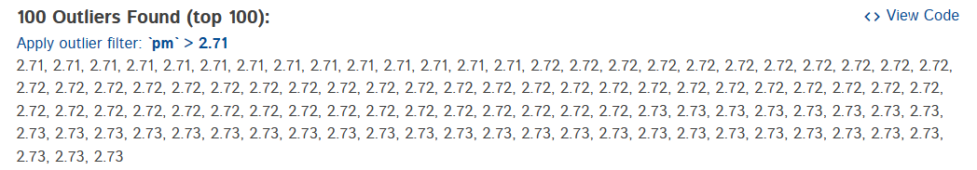
PM

Slide 20

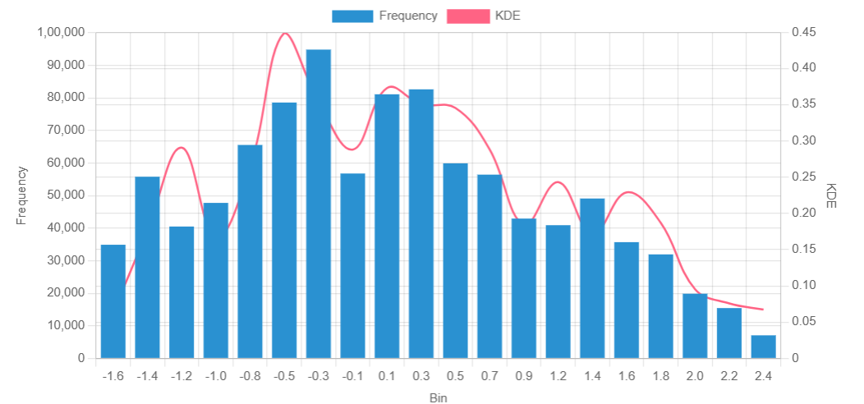
Stator Yoke

Slide 21
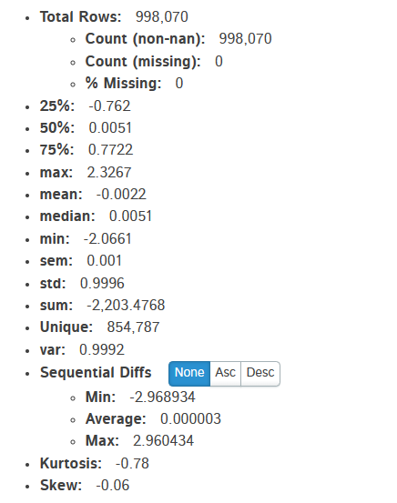
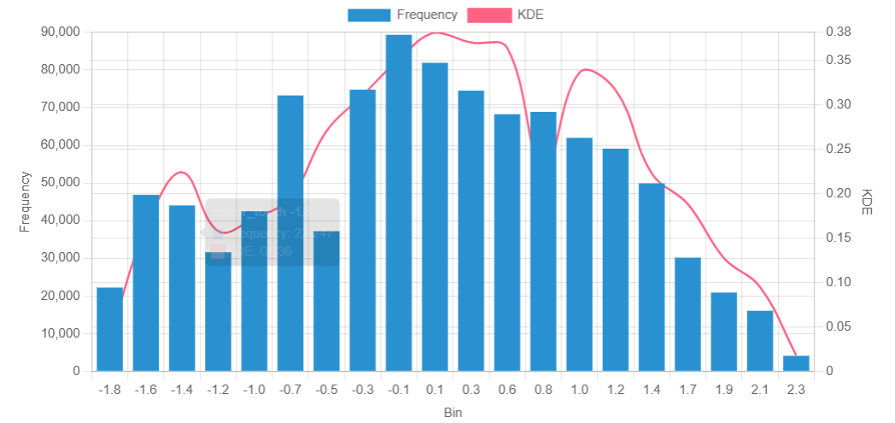
Stator tooth

Slide 22
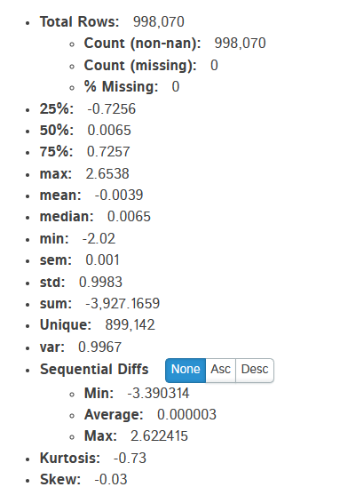
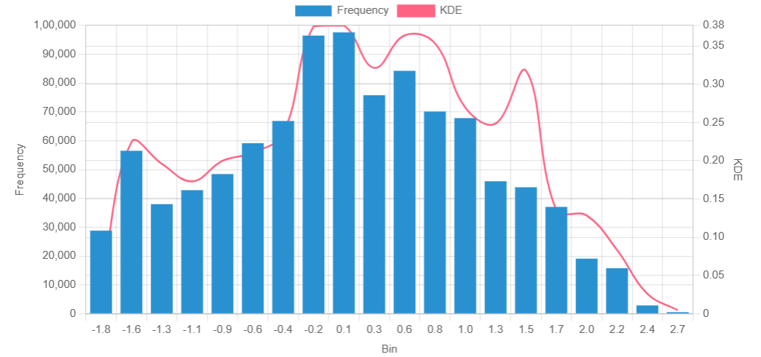
Stator winding

Slide 23
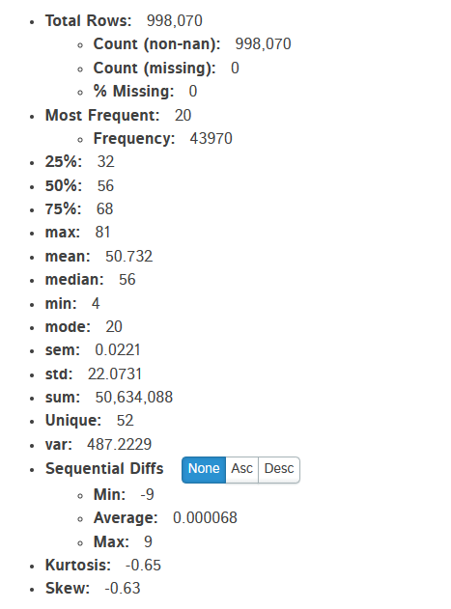
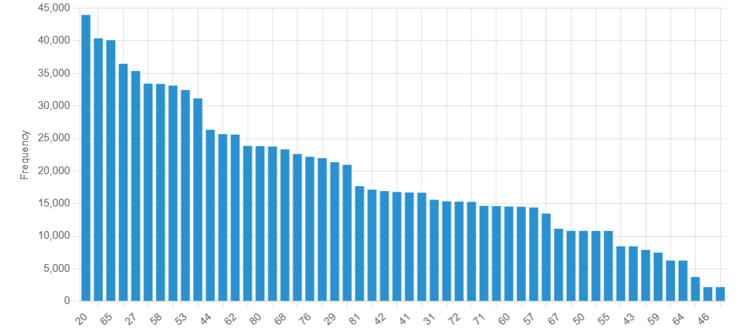
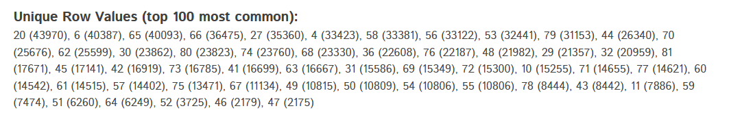
Profile Id

Slide 24
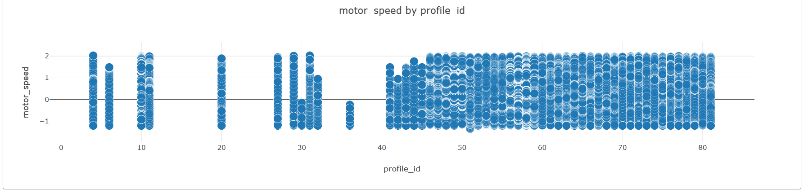
Scatter plots
It has been Observed that Profile id is Unique Measurement session and each Session are unique and Independent.

Slide 25
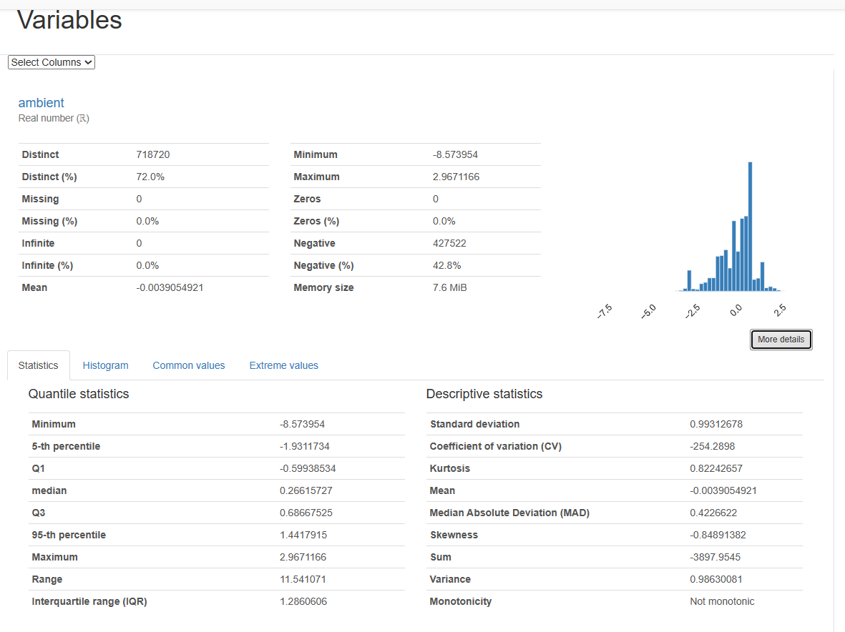
Auto EDA USING PANDAS PROFILING

Slide 26
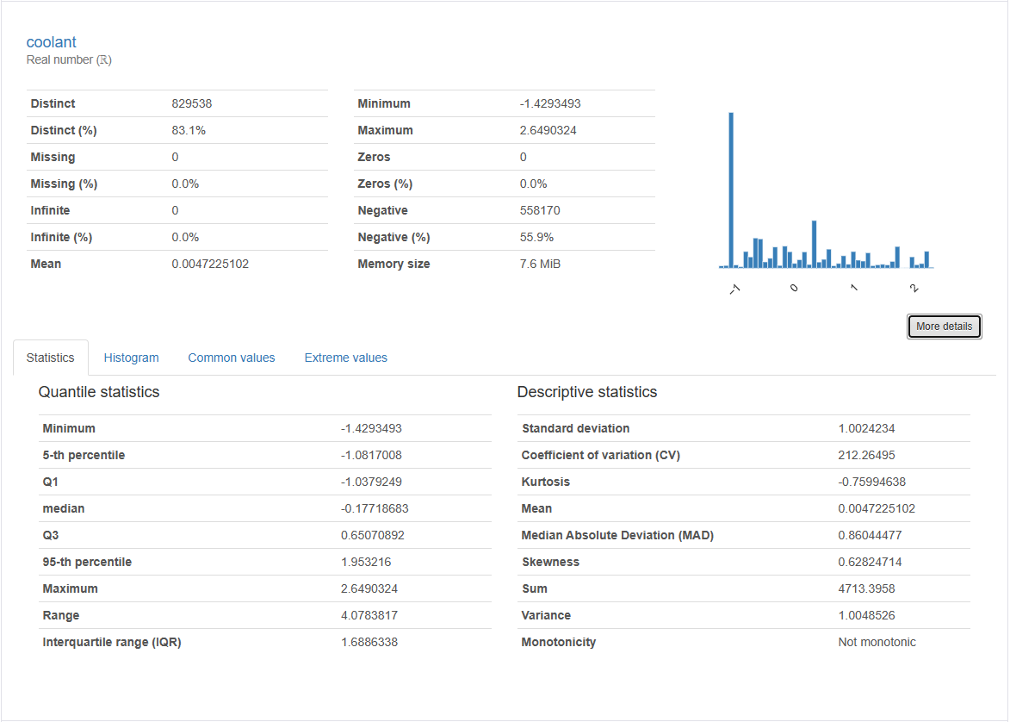

Slide 27
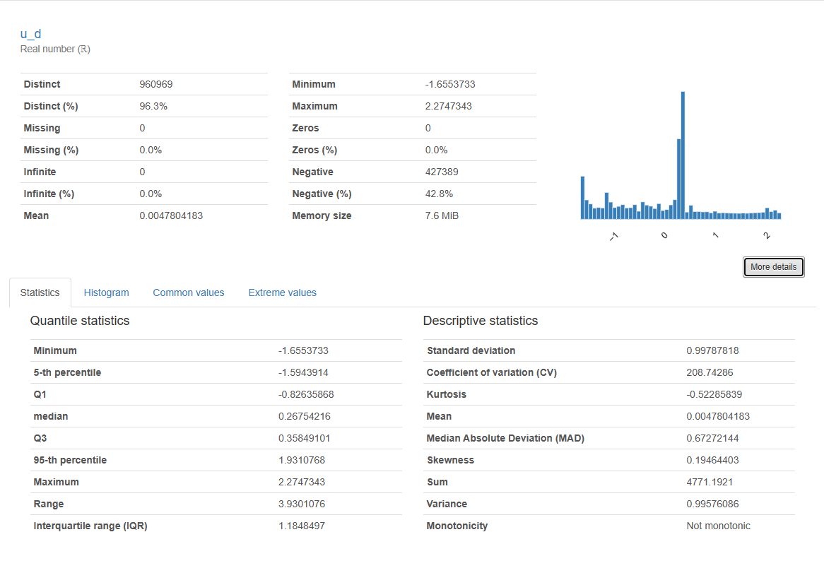

Slide 28
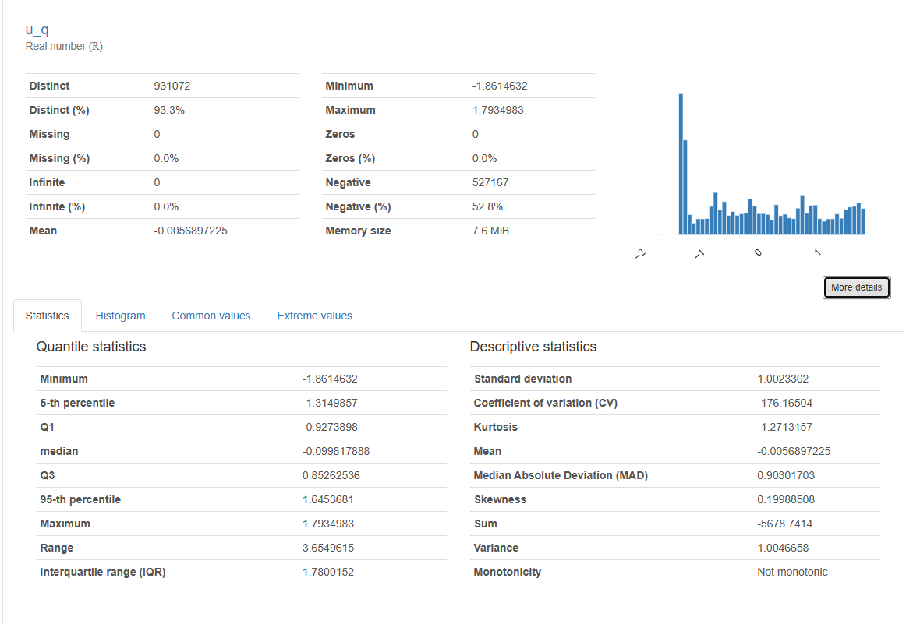

Slide 29
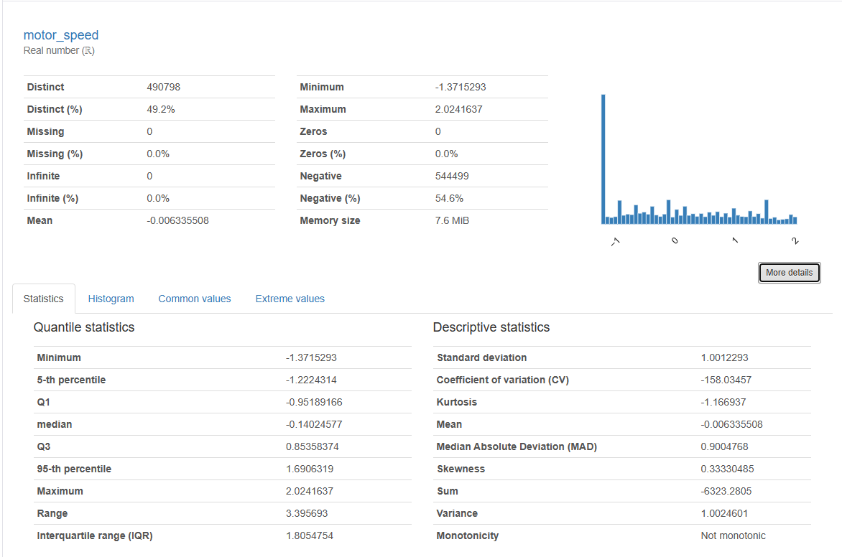

Slide 30
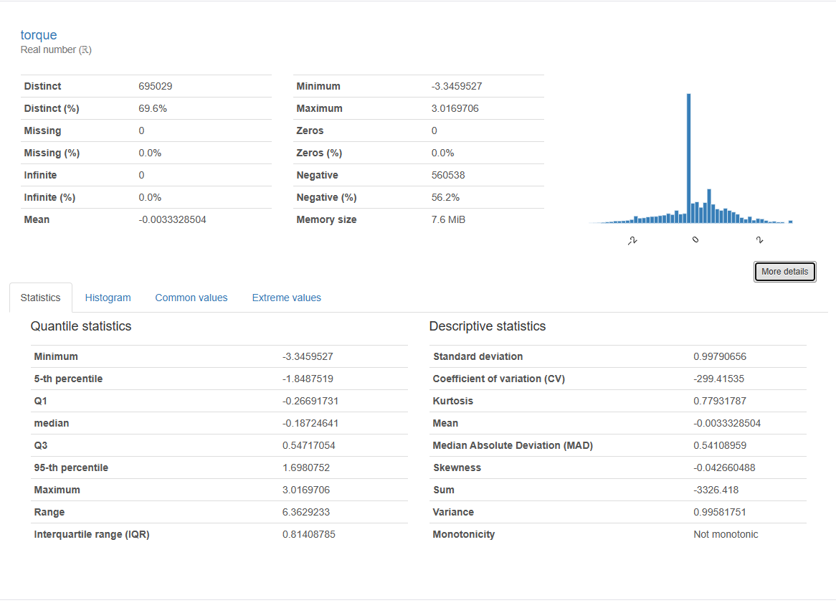

Slide 31
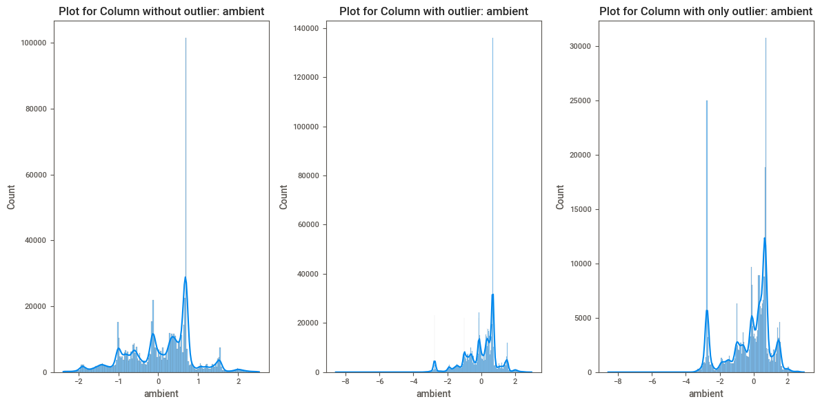
Histogram plotting of different columns for without outliers, with outlier and with only outlier

Slide 32
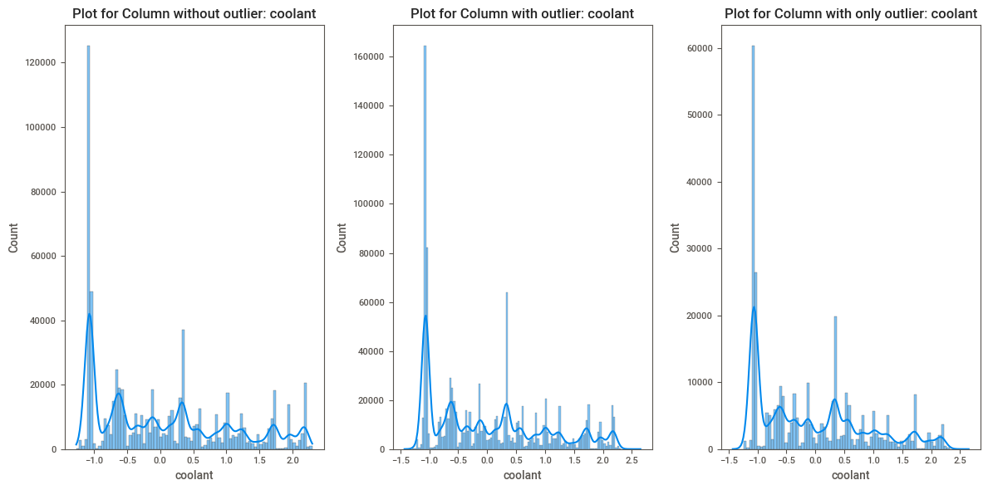

Slide 33
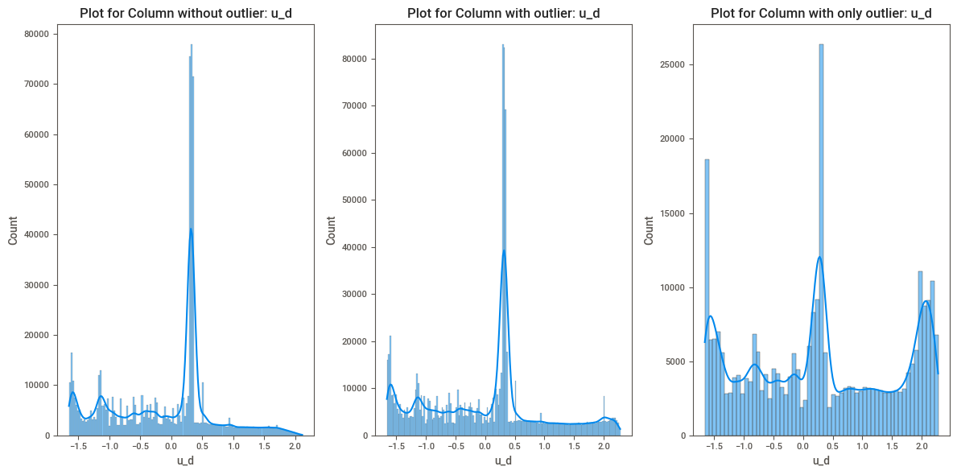

Slide 34
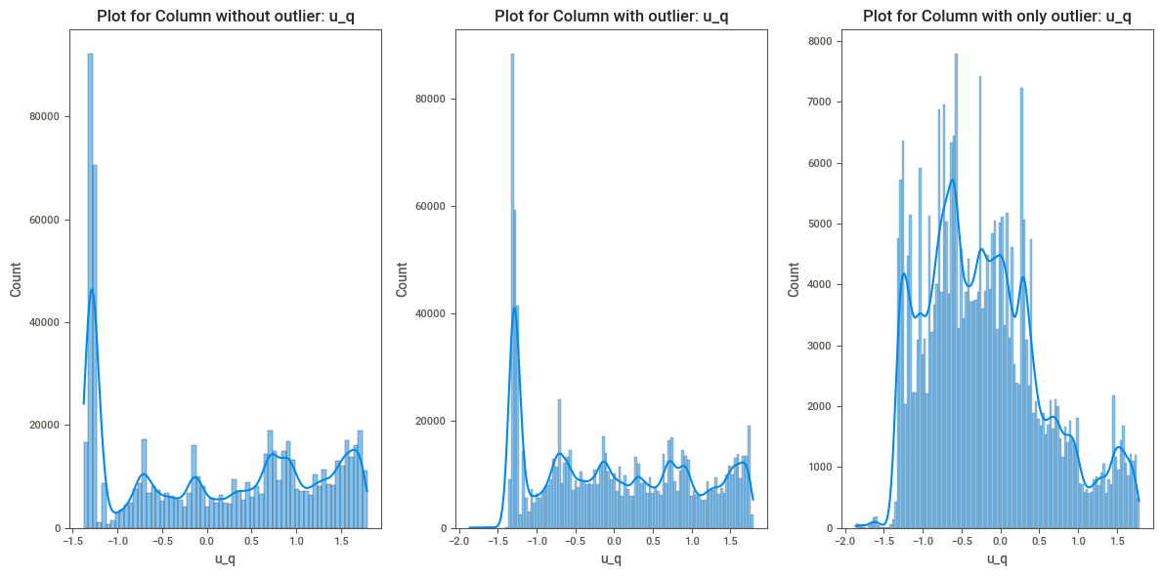

Slide 35
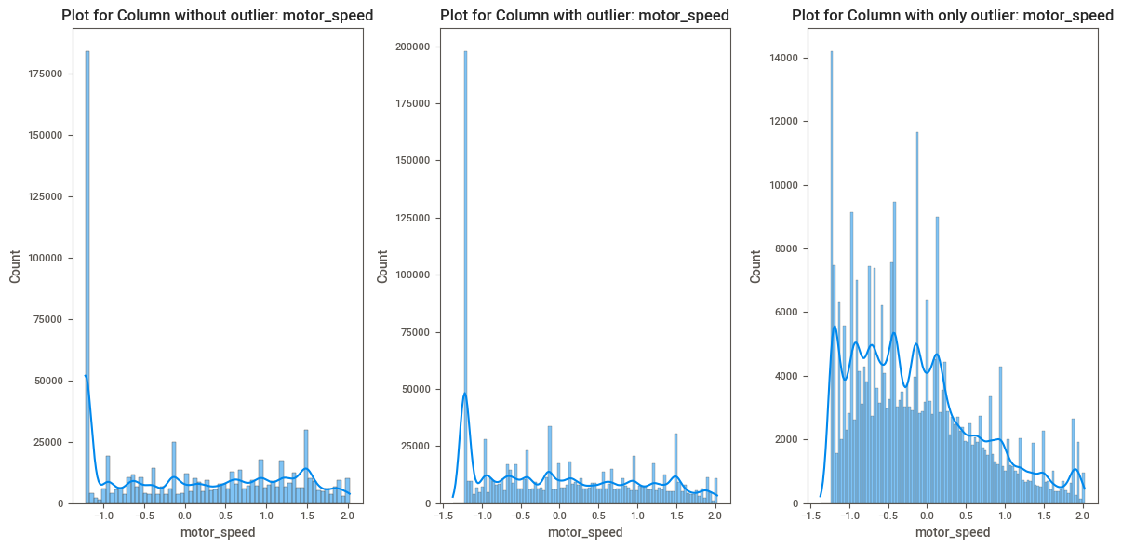

Slide 36
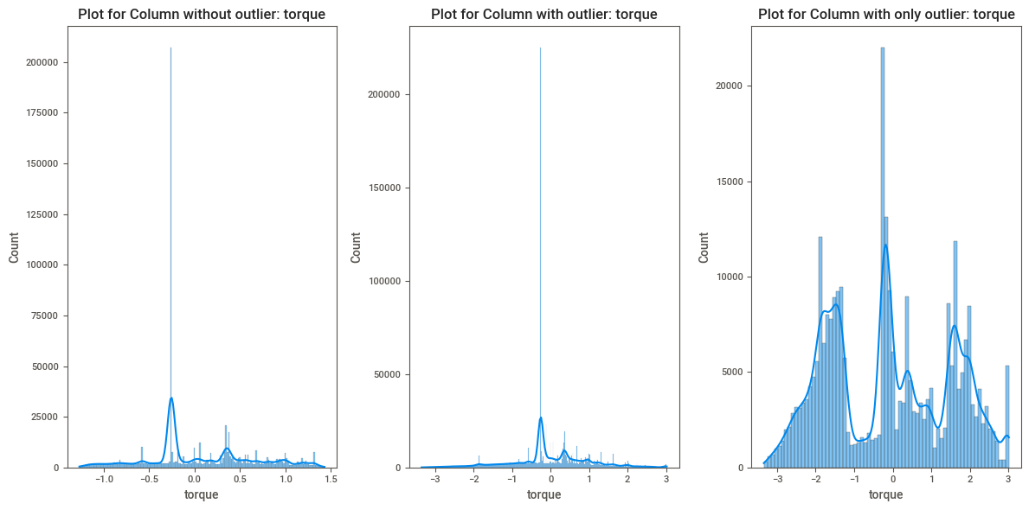

Slide 37
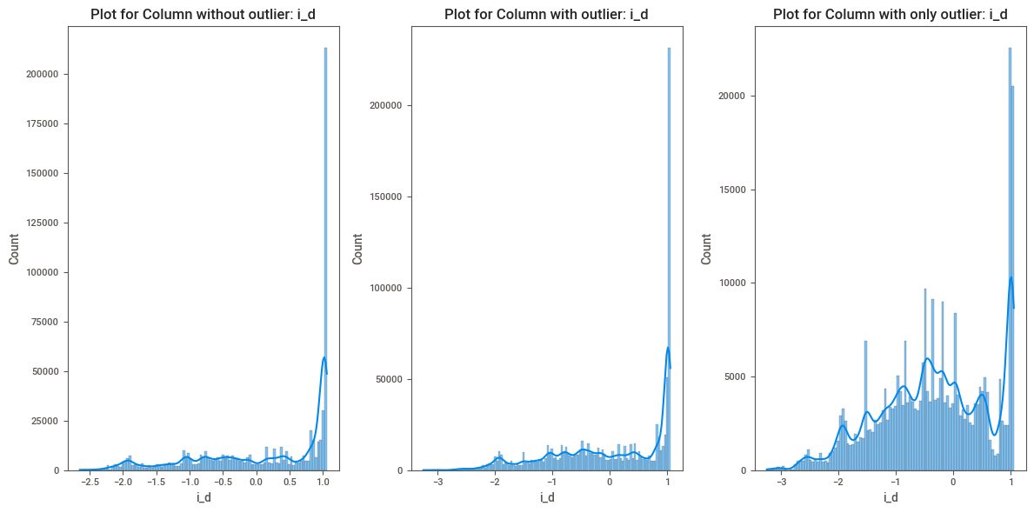

Slide 38
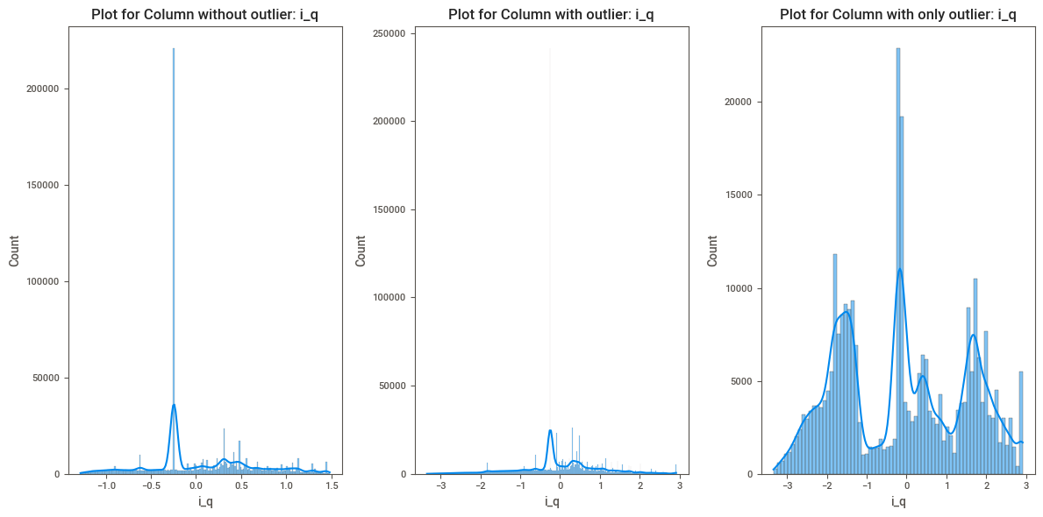

Slide 39


Slide 40


Slide 41


Slide 42


Slide 43


Slide 44
Model Building
SIMPLE LINEAR REGRESSION
After completion of EDA, we started model building by starting with Simple Linear Regression. First, we did data splitting into 80:20. After we did model fitting of Simple Linear Regression without outliers and Simple Linear Regression with entire data. We calculated the MSE, RMSE, MAE and R-Squared score.

Slide 45


Simple Linear Regression model without outliers.

Slide 46


Simple Linear Regression with Entire Data

Slide 47


elasticnet
ELASTICNET WITH ALL COLUMNS
ELASTICNET WITH 6 HIGHLY CORR COLUMNS

Slide 48


LIGHTGBM
LIGHTGBM WITH ALL COLUMNS
LIGHTGBM WITH 6 HIGHLY CORR COLUMNS

Slide 49


LIGHTGBM (Gridsearch)
LIGHTGBM WITH ALL COLUMNS
LIGHTGBM WITH 6 HIGHLY CORR COLUMNS

Slide 50

All Models metrices and accuracy

Slide 51
Deployment
According to the model validation, we preferred LightGBMGrid with all columns for the deployment. It has the perfect R-Squared value with 99% and it is the perfect model for the deployment purpose.

Slide 52


Slide 53


Slide 54
Problems faced
As the dataset was huge we had problems with models taking time longer than expected to evaluate.
While doing visual analysis we had to break data into samples rather than doing analysis on population.

Slide 55
THANK YOU

